Slide 1



Student course enrollment project
Vicki kelm
The university of Arizona global campus
Cst499: Capstone for computer software technology
Dr. Amjad alkilani
January 28, 2024
Notes:
Hello, my name is Vicki Kelm. Today I will be providing an overview of a student course enrollment system which is a software development project that I built as part of my capstone course at The University of Arizona Global Campus (GO CATS!!) for my Bachelors of Science in Computer Software Technology program.

Slide 2
Project Objectives and purpose
Take aways
Project Purpose
Key aspects of the Software Requirements Specification (SRS) document developed
UML design models created
Design of the basic pages created: Landing, Login, and Enrollment pages
Database and class registration design
PHP Source Code
Notes:
The take aways for this presentation with be to provide an understanding of the project purpose, key aspects of the Software Requirements Specification, otherwise known as the SRS document developed, the UML design models created, the design of the database, the design of the basic pages for the system that include the Landing, Login, and Enrollment pages, the basic features of the system, and an explanation of the PHP source code used.

Slide 3
Project Purpose
Project Purpose
Create a functional and user friendly course enrollment system
Technology
XAMPP, HTML, Bootstrap, CSS, MySQL, PHP
System Development Requirements
Student ability to create an account, login, logout
Student ability to view course schedule
Student ability to enroll/unenroll in courses
Notes:
The purpose of the project was to create a functional and user friendly course enrollment system. The technologies used for the system development include XAMPP, which is the server for the website using Apache for the platform. The other technologies used to build the system include HTML, Bootstrap, CSS, MySQL, and PHP. The basic functionalities and requirements for the system is that the student will be able to register or create an account, then login to the website using the credentials for the account created, and then be able to logout. The student will also be able to add or enroll in courses, view their course schedule, and then be able to unenroll or remove a course from their schedule.

Slide 4
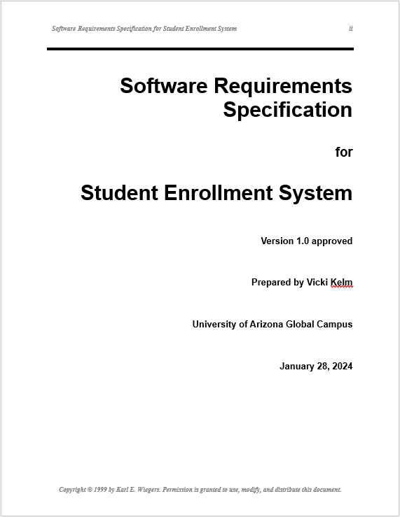
Software Requirements Specification (SRS) Document
Q: What is a Software Requirements Specification (SRS) document?
A: Provides a detailed overview of the software product, purpose, requirements and features (Titov, 2023).
SRS Overview
During the elicitation of the requirements, a software requirements specification (SRS) is generated. Here, all artifacts gathered during the project discussion meetings and design phases are captured here.
The SRS serves decision makers and designers.
Notes:
Next I will discuss the Software Requirements Specification or SRS document. The SRS is a “document that provides a detailed overview of the software product, purpose, requirements and features” as defined by Max Titov from Altigee Magazine.
During the elicitation of the requirements, a Software Requirements Specification (SRS) is generated. Here, all the artifacts that are gathered from the project discussion meetings and design phases are captured. The SRS serves decision makers and designers.

Slide 5
UML Design Models
“Unified Modeling Language (UML) is an object-oriented modeling language that provides the elements and relationships to model software requirements and design” (Tsui, Karam, & Bernal, sect. 4.3.1).
There were several UML models created for the Student Enrollment System. These models include: Class Diagram, Sequence Diagram, Activity Diagram, State Diagram, and Use Case Diagram.
The UML models capture the key design and requirement aspects of the system based on the SRS document developed for the project.
The designing of the UML models provides the tools needed for the development team to provide validation that the developed software meets the needs of the customer.
Notes:
The next section of the presentation is to discuss the different UML models developed for the student enrollment system based on the project requirements.
The definition of UML or Unified Modeling Language is that it “is an object-oriented modeling language that provides the elements and relationships to model software requirements and design” based on Tsui, Karam, & Bernal the author of the course text.
There were several UML models created for the Student Enrollment System which includes a Class, Sequence, Activity, State and Use Case diagrams.
The UML models created are used to capture the key design and requirement aspects of the system based on the SRS document developed for the project.
The designing of the UML models provides the tools needed for the development team to provide validation that the developed software meets the needs of the customer.

Slide 6
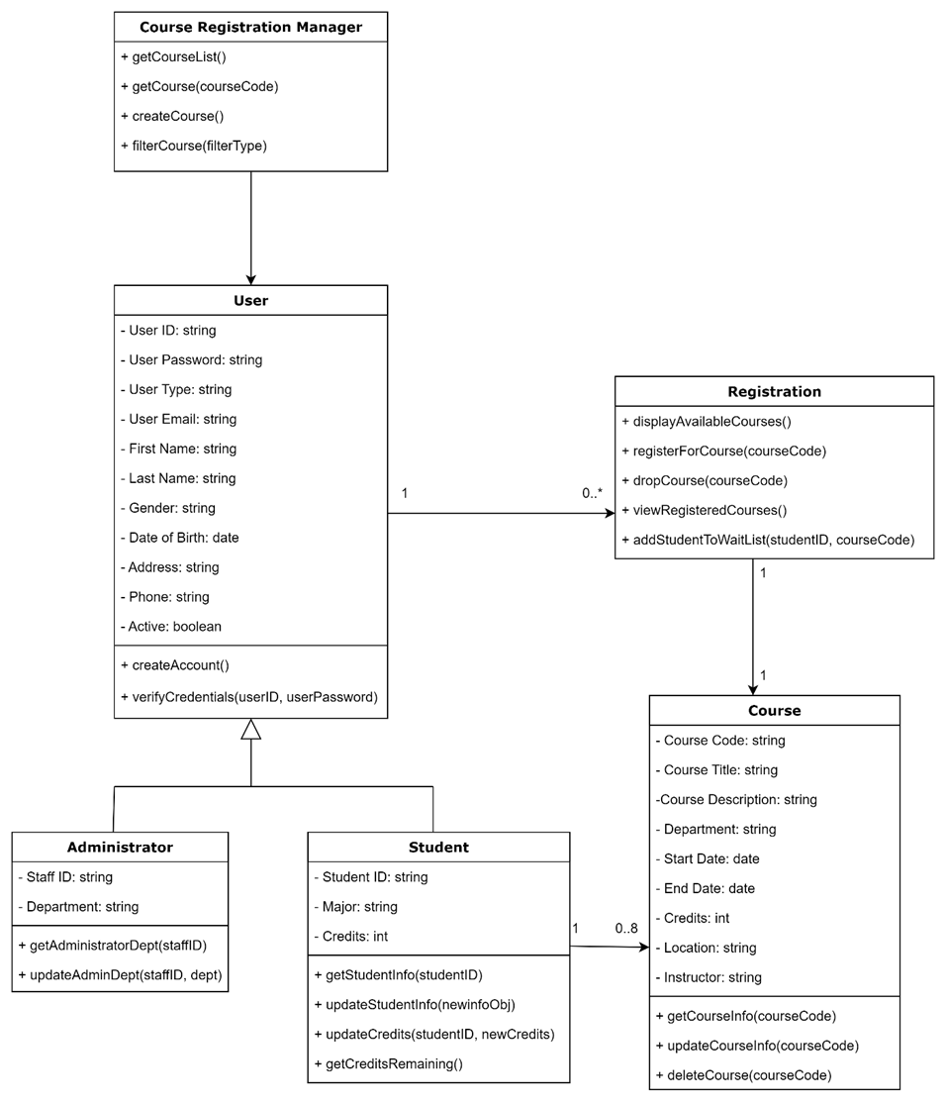
Class Diagram
Class Diagram: A structural illustration of the system classes, interfaces, associations, and constraints
Classes include: Users, Registration, and Courses
The User is a superclass to the student and administrator subclasses
Each class contains attributes that describe the class in the first section, and operations that follow in the second section of the class
Notes:
Next I will discuss the different UML models created for the project. The first model is the Class Diagram.
The Class Diagram is a structural illustration of the system classes, interfaces, associations, and constraints. The classes include: Users, Registration, and Courses.
The User is a superclass to the student and administrator subclasses.
Each class contains attributes that describe the class in the first section, and operations that follow in the second section of the class.

Slide 7
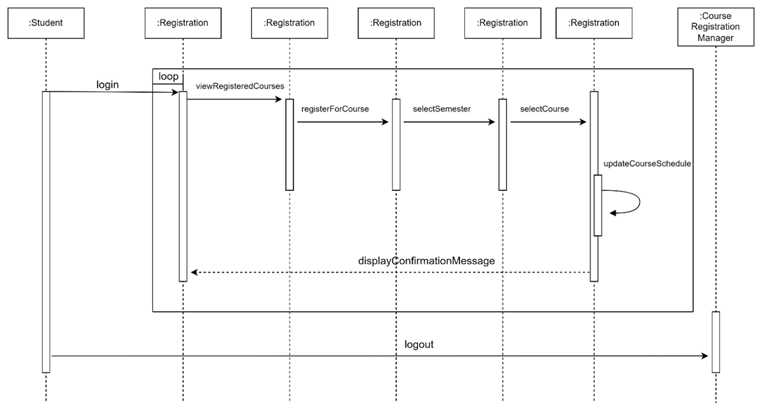
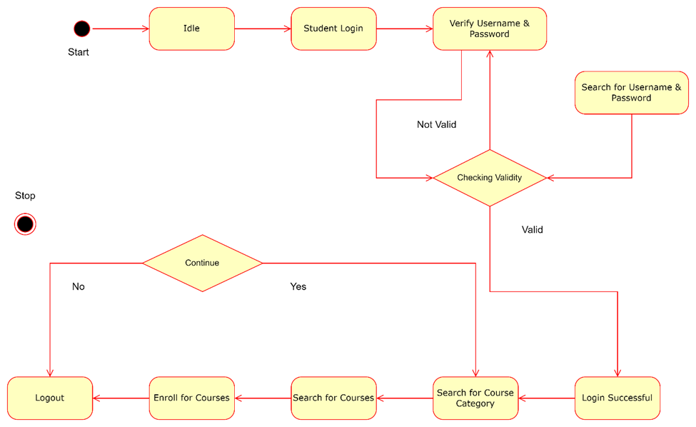
Sequence and State Diagrams
Sequence Diagram: Illustrates the message flow from one object to another
Example: student logs in, diagram shows the info ties back to the registration info, once verified, the user can access the course information
State Diagram: Represents the behavior of complex systems and describes the various states that a system can be in and the events or conditions that cause transitions between the states (VisualParadigm, 2023).
Notes:
The Sequence and State diagrams are the next topics of discussion.
The Sequence Diagram is the first image in the slide. It illustrates the message flow from one object to another.
Example: student logs in, this ties back to the registration info as shown in the diagram. Once verified, the user can then access the course information.
The State Diagram “represents the behavior of complex systems and describes the various states that a system can be in and the events or conditions that cause transitions between the states” (VisualParadigm, 2023).

Slide 8
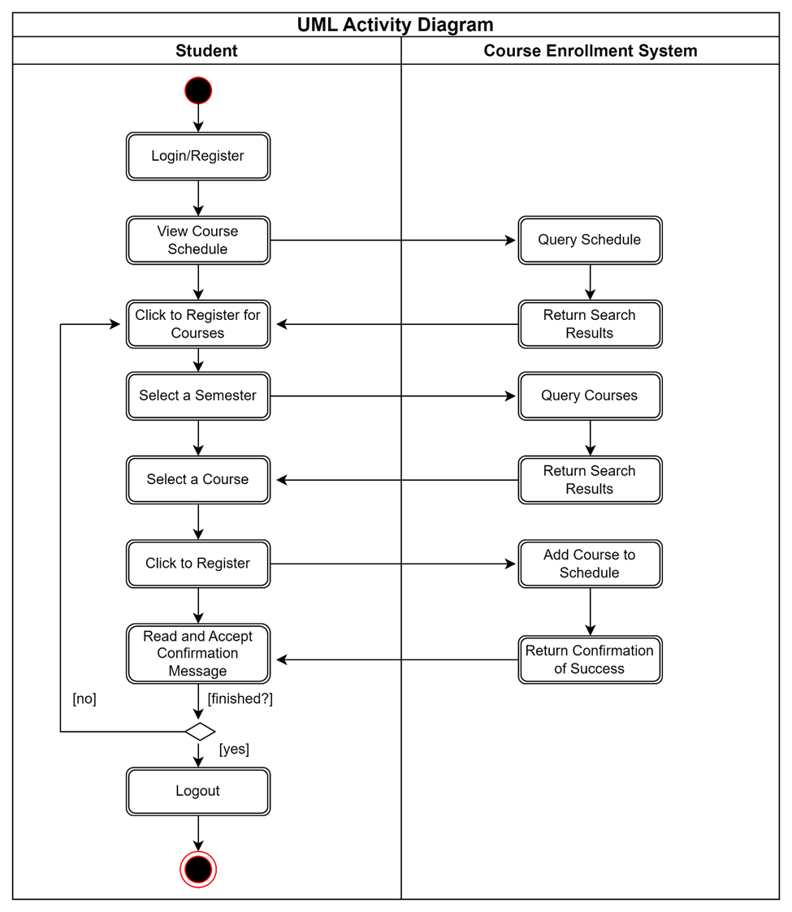
Activity Diagram
Activity Diagram: Illustrates the flow from one activity to another activity
Example: Activity of the student logging in, flows to other activities such as enrolling in a class or viewing their course schedule
Notes:
The Activity Diagram is up next.
The Activity Diagram illustrates the flow from one activity to another activity.
Example: Activity of the student logging in, flows to other activities such as enrolling in a class or viewing their course schedule.

Slide 9
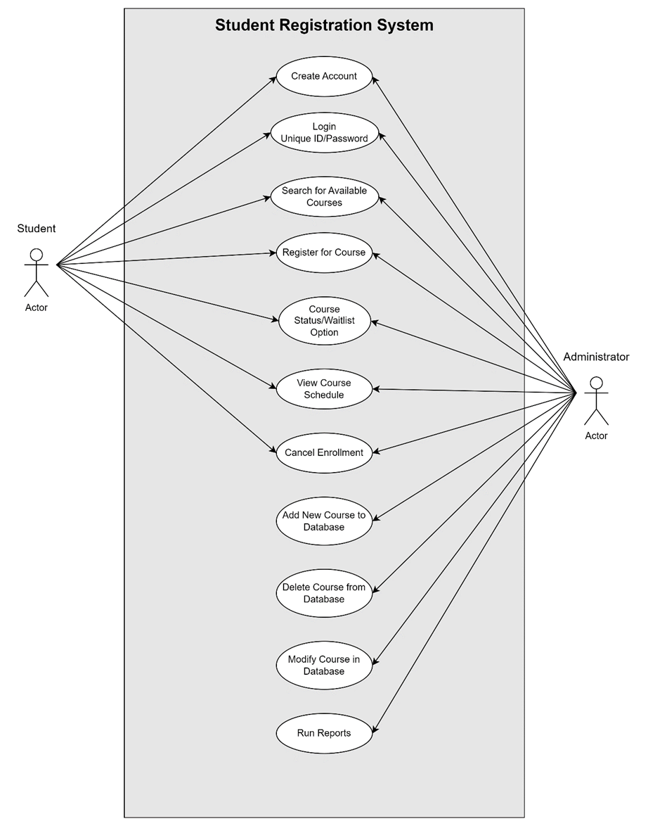
Use Case Diagram
Use Case Diagram: A form of interaction model, and is used to provide a simple overview of the interaction of an actor with a system (Sommerville, 2018).
Example:
Actors: Student or Administrator
Interactions:
Create account
Login/logout
Search for courses
Enroll/unenroll courses
View course schedule
Update course list (Administrator)
Notes:
The last diagram to discuss is the Use Case Diagram.
The Use Case Diagram is a form of interaction model, and is used to provide a simple overview of the interaction of an actor, in this case a student or administrator with the system (Sommerville, 2018).
Example: Actors shown in the diagram are “Student” and “Administrator”.
Interactions include: creating an account, login/logout for both the student and the administrator, searching for courses, adding and removing courses, viewing class schedule, and even the ability for the administrator to update the course list.

Slide 10
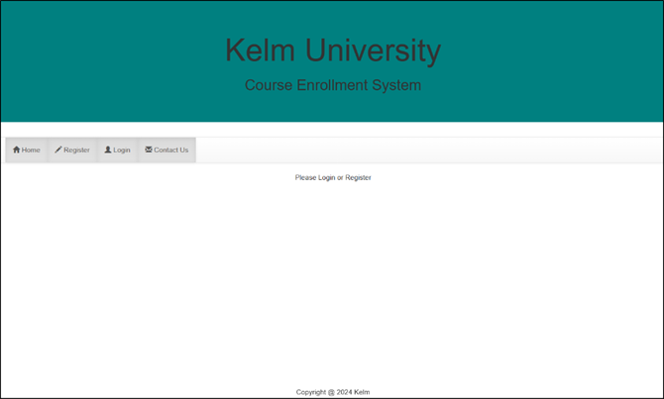
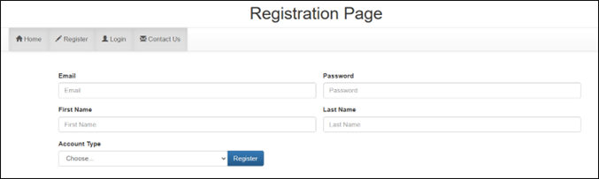
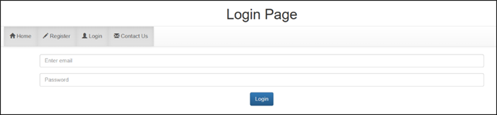
Page design: landing, Registration, login
Landing Page: Simple layout with bootstrap stylesheets utilized throughout the website.
User navigates to the Registration page from the Landing page, creates an account, then logs in with email/password created
Use of the “ISSET($_SESSION) allows for continuous session login across the site, with the navigation bar linking to each page
Registration Page: Allows users to create accounts allowing for access to website functions.
Use of “INSERT INTO ‘user’ adds the user to the database, allows user to login and perform enrollment functions
Login Page: User remains logged in after credentials are verified against the registration information in the database.
Connection to the database is linked in the PHP file code.
Notes:
The page design aspects are shown here which includes the Landing, Registration, and Login pages created in week 3.
The Landing page is a simple layout that is stylized using Bootstrap which is also utilized throughout the website. The user navigates to the Registration page from the main Landing page, creates an account, then logs in with their email/password combination created. The use of “ISSET($_SESSION) command allows for continuous session login across the site, with the navigation bar linking to each page.
The Registration page allows users to create accounts which allows them access to the website functions. Using “INSERT INTO” ‘user’ adds the user to the database allowing for login and enrollment functionalities.
The Login page allows the users access to the website after registering for an account. The login username/password combination is verified against the registration information in the database. The connection to the database is included in the PHP file code.

Slide 11
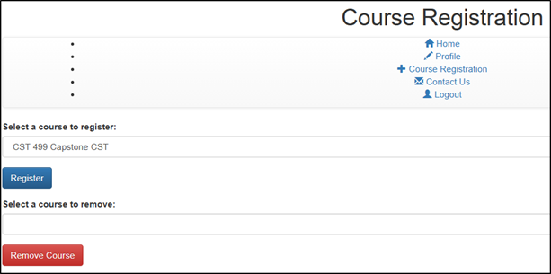
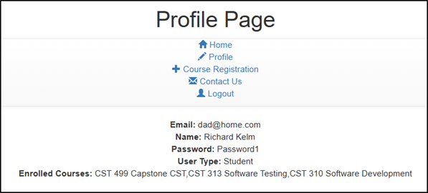
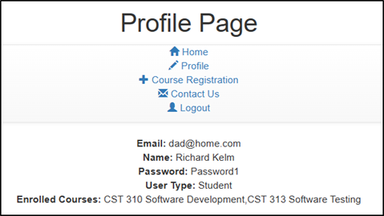
Course Registration and Profile Page
Course Registration Page: Used to enroll/add or unenroll/remove courses from student schedule
Profile Page: Shows courses added to students schedule
Profile Page: Result after removing course “CST 499 Capstone CST” from student enrollment
Notes:
The screenshots illustrate the process of adding/removing courses from student, Richard Kelm’s enrollment.
The Course Registration page is where the student or administrator can add or remove courses.
The Profile page lists the student information to include the enrolled courses for the student.
The second Profile page shows when a course was removed from the student’s enrollment.

Slide 12
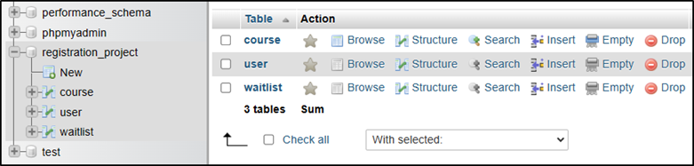
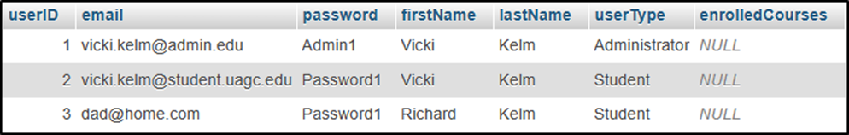
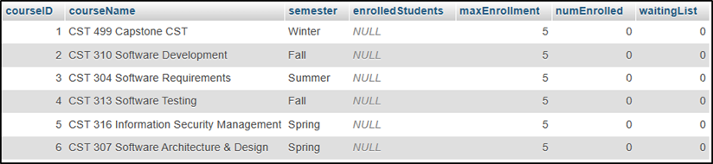
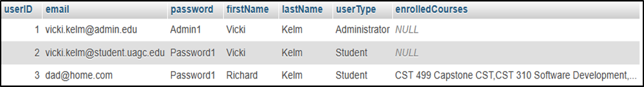
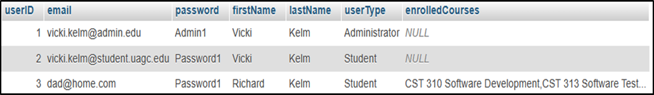
MySQL Database, User and Course Tables
MySQL Database: registration_project
Table: course – lists available courses
Table: user – lists all registered users
Table: waitlist (to be utilized in a future project)
user Table: Shows all registered users before courses are enrolled
course Table: Shows all available courses
user Table: Shows enrolled courses for student Richard Kelm
user Table: Shows removed course from student Richard Kelm’s enrollment
Notes:
The MySQL database that was created is “registration_project”. The screenshot of the database shows the tables contained withing the DB. The tables created are “user”, “course”, and “waitlist”.
I have included screenshots of each of the tables, along with images of the user table before after the student Richard Kelm enrolled in courses, and after unenrolling in a course.

Slide 13
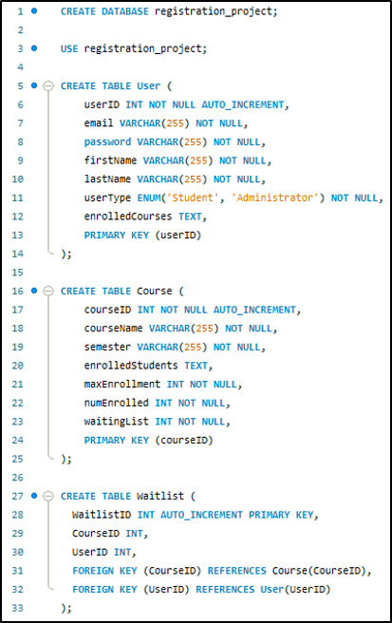
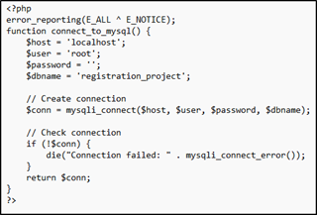
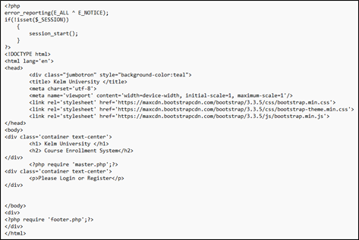
PHP Code
PHP Code to create the database “registration_project” and tables to store user, course, and waitlist information
Connect file used to access the database
Code used to create the main website page
Notes:
Here is some of the code used to create the database and tables, the Landing page for the website, and also the file used to connect the files to the database.
This concludes my presentation.
Thank you for watching.

Slide 14
References
Mikoluk, K. (2013, September 18). XAMPP tutorial: How to use XAMPP to run your own web serverLinks to an external site.. Udemy. https://blog.udemy.com/xampp-tutorial
Sommerville, I. (2016). Software engineering (10th ed.). Pearson.
Titov, M. (2023, February 02). How to Write An SRS Document, or Software Requirements Specification. https://www.altigee.com/magazine/how-to-write-an-srs-document-or-software-requirements-specification
Tsui, F., Karam, O., & Bernal, B. (2018). Essentials of software engineering (4th ed.). Jones & Bartlett Learning.
VisualParadigm. (2023, March 22). Introduction to State Diagrams: A Comprehensive Guide for Software Engineering. https://guides.visual-paradigm.com/introduction-to-state-diagrams-a-comprehensive-guide-for-software-engineering/
Notes:
Reference list used for this presentation and were also utilized in the development of the project and final paper submitted. Thank you for watching. I hope that this presentation has provided the details of the project and leave the viewer with the understanding of the project and system requirements. Thank you again and take care.

